Slide 1


Performance Margins for Snowmaking
Analytics that maximize snow production & minimize energy use
Snowmaking Efficiency, LLC
This presentation shows how to use data analytics and Performance Margins to better manage your snowmaking.

Slide 2
Do You Ever Wonder…?
What is really going on with your snowmaking?
Is the system always operating at maximum production?
How to identify and improve lost snow production?
How to identify and minimize energy waste?
If you are using snowmaking data to measure best practices?

Slide 3

For Answers…You’ve Come to the Right Place
  See Benchmark Analytics that…
    Demystify the snowmaking process
    Quantify productivity
  See tangible Performance Margins that…
    Empower snowmakers with useful Key Performance Indicators (KPI’s)
    ID and correct wasted snow production.
    ID and correct wasted energy.
    Measure actual snowmaking performance to potential snowmaking performance.
    Quantify you are making the most snow for the least expense.

Slide 4
How To…Measure Performance & Productivity
Step 1 is to think differently about measuring snow production.
  Typical snowmaking measures performance with averages and totals of GPM.
  GPM is a one-dimensional output, not a measure of efficiency.
  Because GPM is time-based instead of temperature-based, it is not properly weighted to measure snowmaking performance. Numbers are easily skewed by a few days of cold temps or a week of warm temps.
  Progressive snowmaking thinks like a manufacturing facility – by using multi-dimensional metrics to measure operational performance.
    Temperature-based KPI’s report Performance Margins that quantify:
      $Cost/Acre-Foot of Snow
      Energy Efficiency

Slide 5
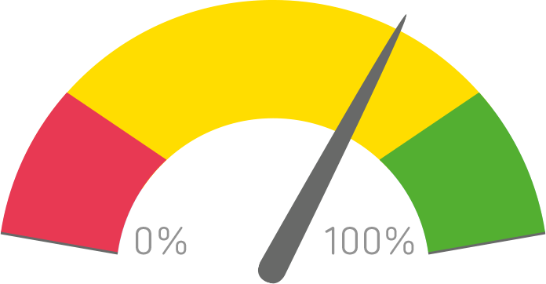
How To…Measure Performance & Productivity
The best analytic for measuring operations like snowmaking is Regression Analysis. This is because it…
  Fairly weighs the variable of temperature.
  Uses raw data from all operational resources, (water, energy, temperature and labor) And not just GPM.
Raw data is computed into operational benchmarks.
And then real-time operations are measured against it to show
Performance Margins.
These analytics have been used in manufacturing for decades.
  They quantify hourly performance for the entire manufacturing process.
  Productivity is standardized across all temperatures and operating conditions.

Slide 6
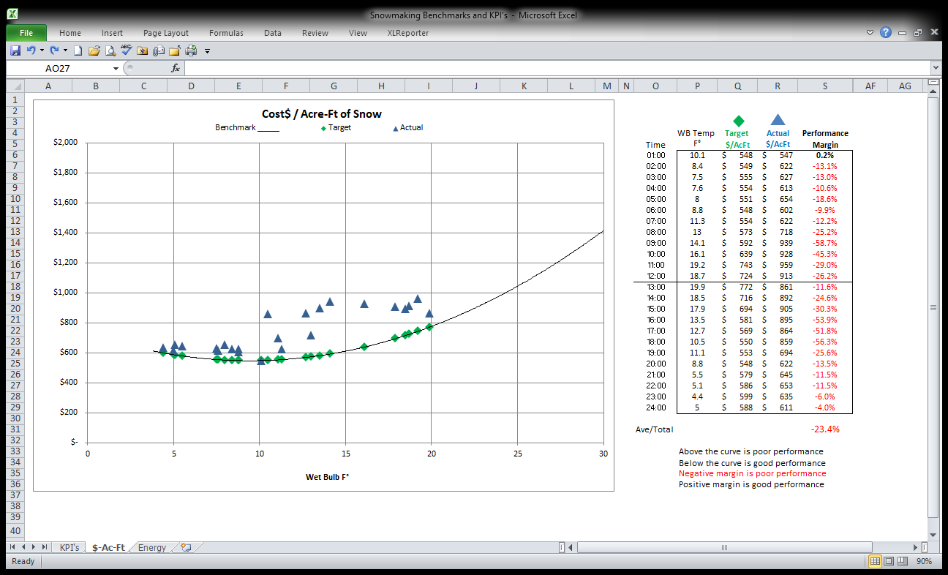
Snowmaking Performance Data
Here is an example of performance data and performance margins for 24 hours of snowmaking.
Data points above the benchmark curve (Target) shows poor performance.
Data points below the benchmark curve (Target) shows good performance.
Values are shown in the chart to the right.
From this one graphic, Managers immediately know the performance of all snowmaking
operations because….Performance Margins are the tell-tale KPI‘s of snowmaking.

Slide 7
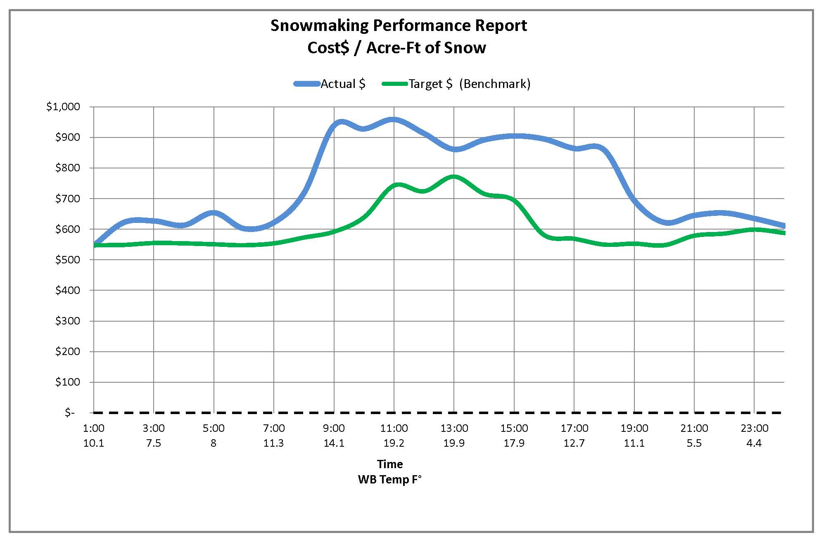
ID Wasted Energy and Production Costs
  With a graph of data values from the previous slide, Managers see the gap between Actual and potential (Target) performance.
The gap identifies wasted energy and wasted dollars. It also pinpoints where improvements can be made to bad practices.
Operational corrections minimize the differential which results in making more snow with less energy and less cost. In all temperatures and operating conditions.

Slide 8

Business Benefits from Performance Margins
  Measure actual snowmaking performance against
  potential (Target) snowmaking performance.
    Minimize the difference to improve production efficiency.
Self-tracking system of performance & accountability.
  Confirm you making the most snow for the least expense,
  in all temperatures.
Reduce production costs and energy waste by knowing exactly when they occur.
  Hourly reporting when improvements can be made.

Slide 9
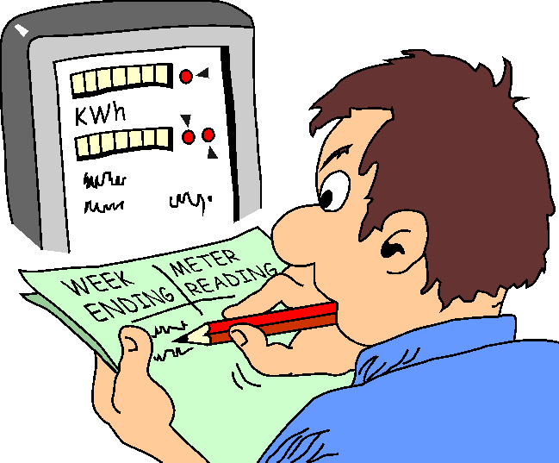
Simple 4 Step Process
1. Collect Raw Data
Energy
Water flow
Labor
Wet Bulb Temperature
2. Compile Performance Benchmarks (temperature-based)
3. Compare hourly operations to the benchmarks
4. Make adjustments and corrections for improved performance
If you would like to measure and improve snowmaking with Performance Margins, here is the process.
The next few slides show examples of each step.

Slide 10
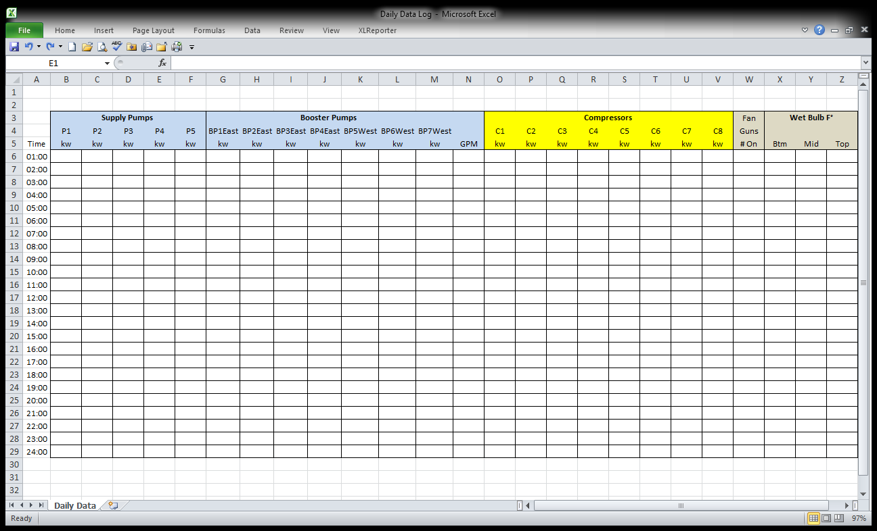
1. Collect Raw Data
Here is an example of a data collection form. Raw data for energy, water flows and temperatures, is collected and typed into the form by snowmakers.
Or automatically populated from your operating system.

Slide 11
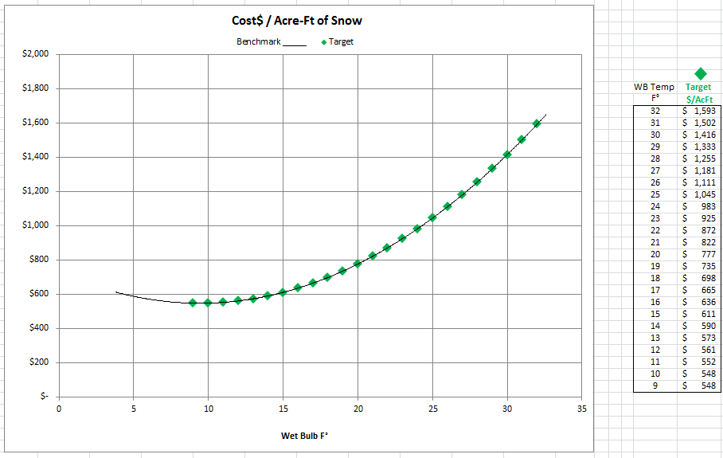
2. Compile Performance Benchmarks
Benchmark for Cost$/Acre-Ft of Snow
Step 2 is to compile the performance benchmark. This is an example of a Benchmark and Targets for Cost per Acre-Foot of Snow.
This curve includes the entire snowmaking process for each degree of temperature.
(Note that data is site-specific and not and an industry standard.)

Slide 12
3. Compare Actual Operations to the Benchmark
Once the benchmark is established, hourly operations are compared against it (Targets) to show Performance Margins.
Once the benchmark is established, hourly operations are compared against it (Targets) to show Performance Margins.
Data points above the curve shows poor performance,
Data points below the curve shows good performance.
Values are shown in the chart to the right.
From this one graphic, Managers immediately know the performance of all snowmaking operations because….Performance Margins are the tell-tale KPI‘s of snowmaking.
Data points above the curve shows poor performance,
Data points below the curve shows good performance.
Values are shown in the chart to the right.
From this one graphic, Managers immediately know the performance of all snowmaking operations because….Performance Margins are the tell-tale KPI‘s of snowmaking

Slide 13
4. Adjustments & Corrections for Improved Performance
How Do Performance Margins Improve Your Snowmaking?
Margins measure operational actions of the entire process, so managers know the value of all practices, including best and worst practices. This knowledge empowers decision-making and adjustments that:
1. Identify and close the gap that exists between actual and potential snow production.
2. Reduce energy waste by knowing exactly when it occurs.
3. Optimize technology of low-e snow guns and automation.
4. Use statistical management methods that account for the effects of temperature, instead of habits.
5. Accelerate the pace of energy savings – by expanding frequency and longevity of best practices.

Slide 14
4. Adjustments & Corrections for Improved Performance
How Do Performance Margins Improve Your Snowmaking?
Your business immediately benefits as the manufacturing process makes and quantifies the most snow for the least expense.
This happens with adjustments to…
Snow gun selection
Compressor bypass
Pump sequencing
Transportation
Field communications
Costs are reduced by 4%-20%.
Depending on the size of the system, annual expenses decrease by $20,000-$100,000 – for the same amount of snow.

Slide 15
Take Away
Do nothing…fact is we can’t manage what we don’t measure.
  Every other department runs on profit (performance) margins
  Why not Snowmaking?
Accounting (analytic) tools are available that Quantify the snowmaking process…with
  Temperature-based systems of accountability.
  Performance Margins that report the gap and values between actual and potential production.
  Metrics that identify and measure energy waste.
  Easy to use Excel format.
Improve productivity while reducing expenses.
  Make more snow sooner, for less cost.
  Measure best practices with asset utilization.

Slide 16

Implementation and Training
Starting Point
Just like all accounting systems, raw data needs to collected, computed and reported for snowmaking.
  Accomplished with manual data collection and spreadsheets or automatically with software.
Our company provides data collection forms, training and software that helps your team benefit from these analytics and best practices.
Further benefits from these management tools are shown on the Best Practices page of our website. http://snowmakingefficiency.com/best-practices/
`

Slide 17
Contact Us
Snowmaking Efficiency, LLC
Brian Tito Alex
406-261-6216
tito@SnowmakingEfficiency.com
©Copyright 2017 All Rights Reserved.
Protected by copyright laws in the USA and international treaties.
Share only with written authorization from Snowmaking Efficiency, LLC
We look forward to working with your team to measure productivity and maximize snow production.
Please contact us with any questions.

Slide 18
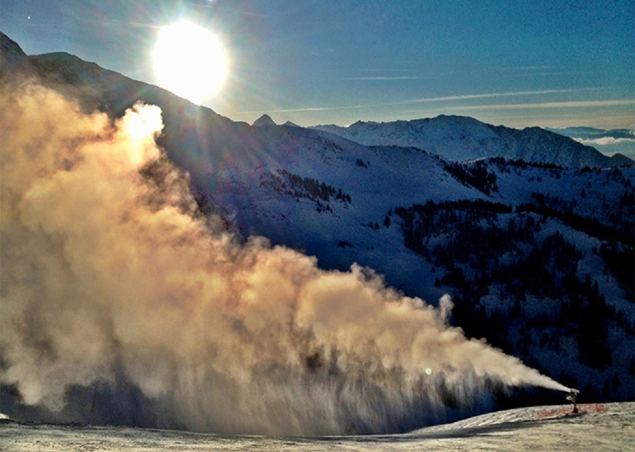
Energy Analytics
Part II - For Energy Managers
The next slides show analytics that measure snowmaking energy performance.

Slide 19

How To…Measure Energy Performance
Energy Management Truths
Snowmaking energy is mostly managed as a measure of
monthly consumption, and not a measure of hourly efficiency.
  Snowmaking energy waste is unidentified and unmeasured.
    ID and Corrections result in making the most snow for the least expense.
You’ve Come To The Right Place
The good news is that analytics are available to properly measure snowmaking energy performance. They use the same four step process shown in the previous slides.
  1. Collect Raw Data
  2. Compile Performance Benchmarks (temperature-based)
  3. Compare operations to the Benchmarks
  4. Make adjustments and corrections for improved performance
The metric for energy performance is kWh/1,000 gallons of water (kWh/KGal)
The next few slides show examples of each step.

Slide 20
1. Collect Raw Data
Here is an example of the data collection form. Raw data for energy, water flows and temperatures, is collected and typed into the form by snowmakers.
Or automatically populated from your operating system.

Slide 21
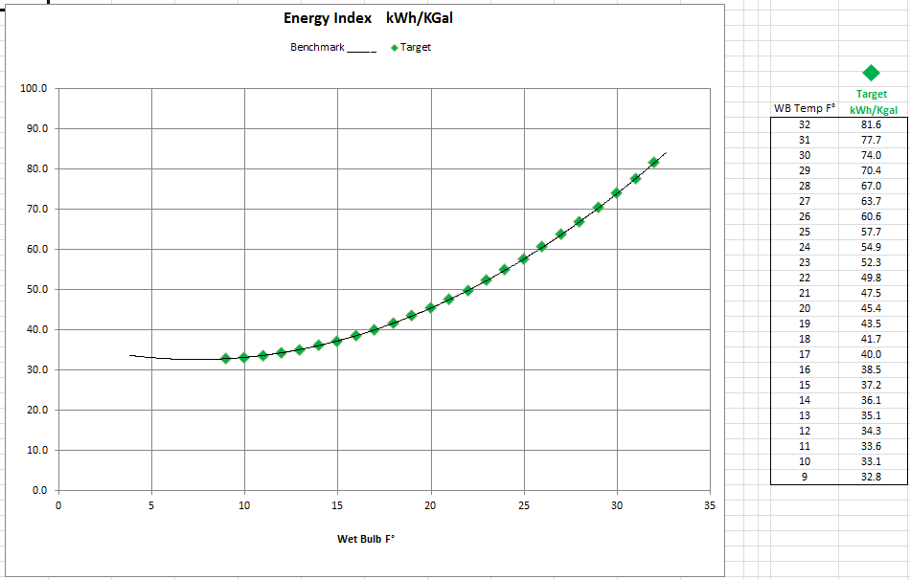
2. Compile Energy Performance Benchmarks
Benchmark for kWh/KGal
Step 2 is to compile the performance benchmark.
The metric is kWh/KGal, for every degree of wet bulb temperature.
Here is an example of a benchmark curve and Targets for Energy Performance.

Slide 22
3. Compare Actual Operations to the Benchmark
After the energy benchmark is compiled,
hourly operations are compared against it (Target)
to show energy performance.
Data points above the curve shows poor performance,
Data points below the curve shows good performance.
Values are shown in the chart to the right.
From this one graphic, Managers immediately know the performance of all energy use because….Performance Margins are the tell-tale KPI ‘s of snowmaking.

Slide 23
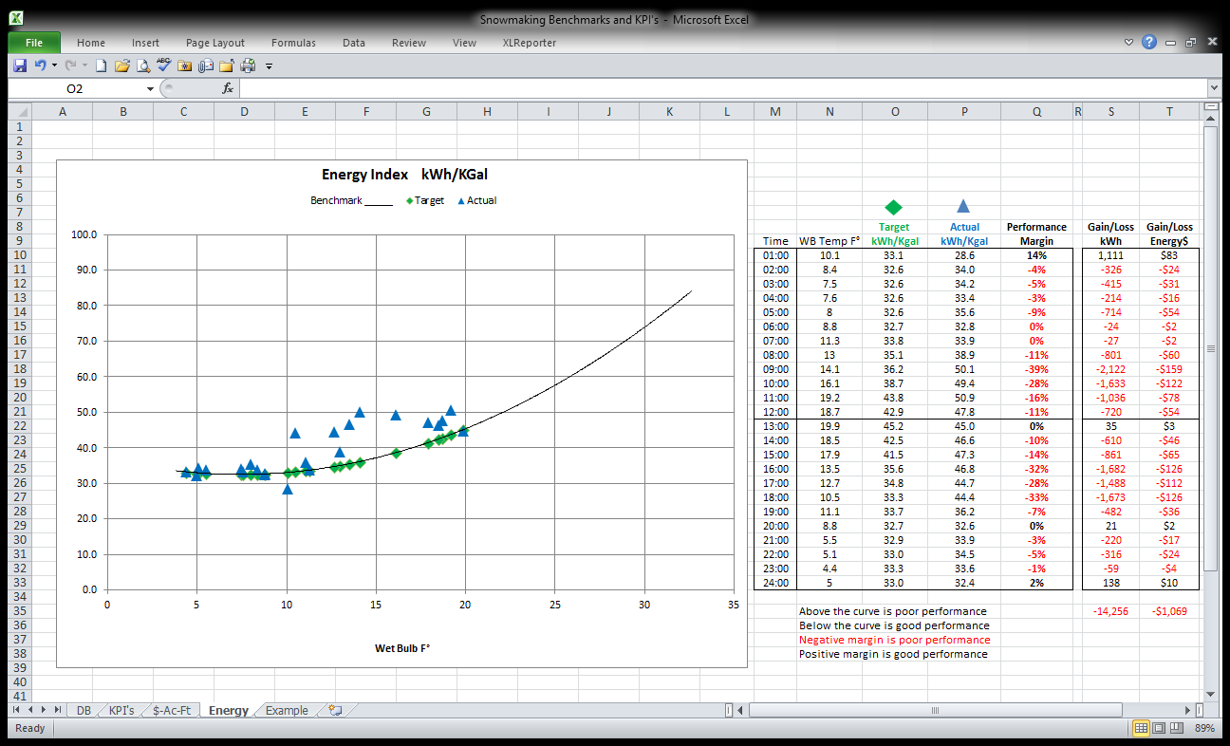
Energy Management
For energy management, data is further calculated into Gains or Loss of kWh and real energy dollars.
This information empowers Managers to make immediate corrections that insure best practices.
(A better management method than using end of month totals; when energy and money has been wasted.)

Slide 24
4. Adjustments & Corrections for Improved Performance
How Do Performance Margins Improve
Snowmaking Energy Use?
Your business immediately benefits as energy waste is identified, measured and corrected. Decisions and actions (best practices) are quantified and reported so that you are making the most snow for the least expense.
This happens with adjustments to…
Snow gun selection
Compressor bypass
Pump sequencing
Transportation
Field communications
Energy costs are reduced by 4%-20%.
Depending on the size of the system, annual expenses decrease by $20,000-$100,000 – for the same amount of snow.

Slide 25
Implementation and Training
Starting Point
Just like all accounting systems, raw data needs to collected, computed and reported for snowmaking.
  Accomplished with manual data collection and spreadsheets or automatically with software.
Our company provides data collection forms, training and software that helps your team benefit from these analytics and best practices.
Further benefits from these management tools are shown on the Best Practices page of our website. http://snowmakingefficiency.com/best-practices/
`

Slide 26

Contact Us
Snowmaking Efficiency, LLC
Brian Tito Alex
406-261-6216
tito@SnowmakingEfficiency.com
©Copyright 2017 All Rights Reserved.
Protected by copyright laws in the USA and international treaties.
Share only with written authorization from Snowmaking Efficiency, LLC
We look forward to working with your team to measure productivity and maximize snow production.
Please contact us with any questions.

